Slide 1
FINAL PRESENTATION -
ANALYSIS OF BIKE SEGMENTS IN IDAHO
Leo Bomboy, Nathan Nguyen, Andrew Plum, Noah Rieth, Anna Ronayne, Jonna Waage

Slide 2
GOAL AND MODE OF COLLECTION
Dataset: Statistically analyzing bike trails in Idaho.
Motivation: Identifying top trials and addressing the research hypothesis
Selection: Chosen for rich content, diverse sources, and easy accessibility.
Source: Data extraction via Stava’s API.
Cleanliness: Minimal column removal or alteration is required.

Slide 3
QUESTION 1
Is there a correlation between athletes’ star ratings of a trail and factors such as distance, average grade, maximum grade, elevation changes, and effort counts?
QUESTION 2
Which cycling routes exhibit the highest level of competition among athletes?
RESEARCH QUESTIONS

Slide 4
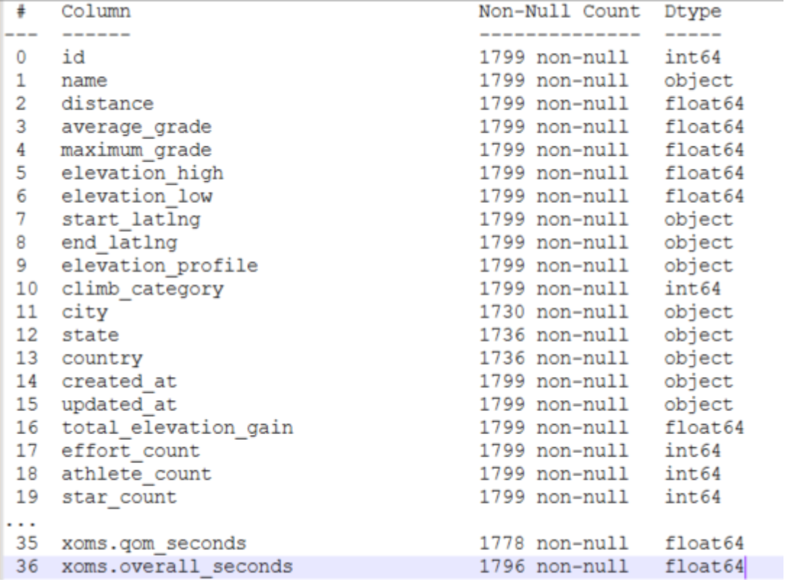
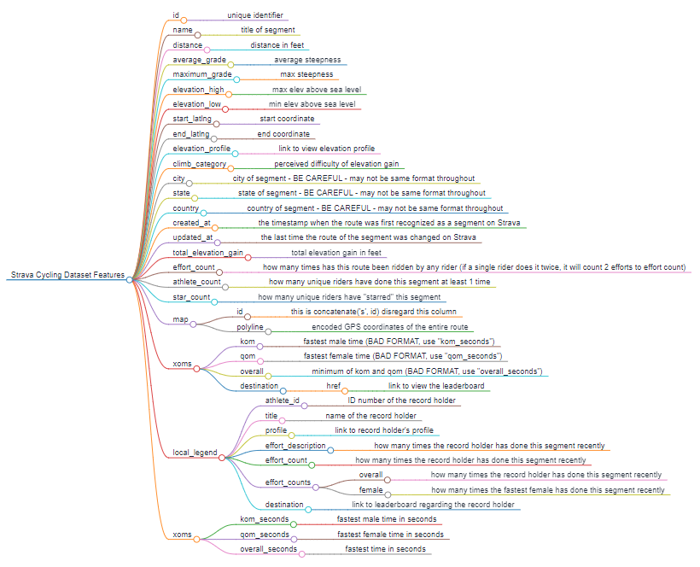
PRELIMINARY VISUALIZATIONS
DESCRIPTION OF THE OVERALL DATASET

Slide 5
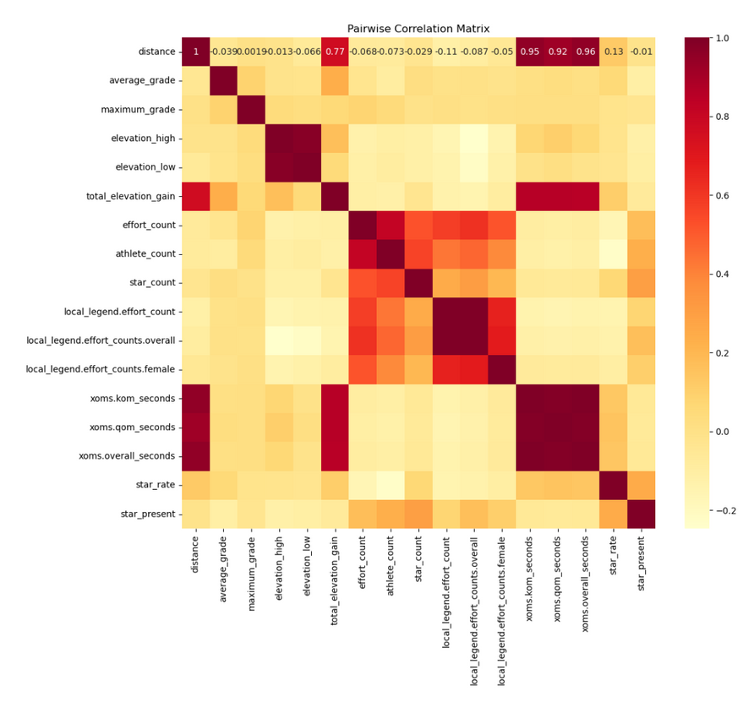
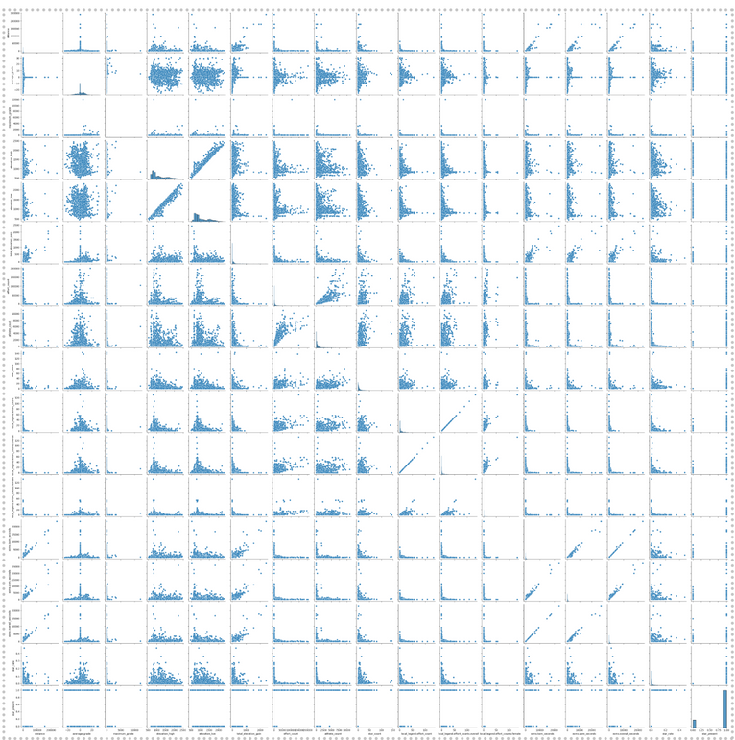
PRELIMINARY VISUALIZATIONS
CORRELATION GRAPHS AND MATRICIES

Slide 6
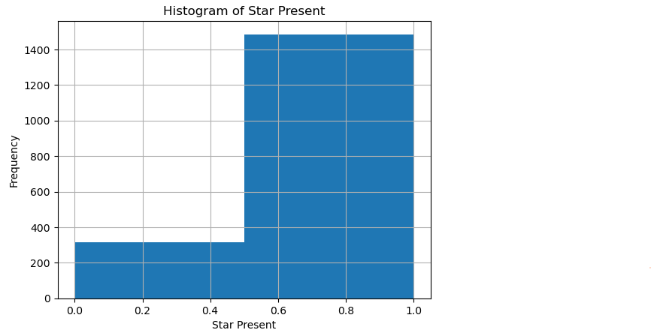
PROPOSED OUTCOME
ACCURATELY DETERMINE WHAT TRAILS WILL BE STARED OR COMPETITIVE
If there is a direct correlation consider elevation height (highest and lowest), athlete count, and effort count to predict if a star is present and competitiveness of the trail.
Analysis was based upon the following criteria
Elevation High
Elevation Low
Athlete Count
Effort Count
Distance
Overall Seconds
Average Grade

Slide 7
1ST QUESTION ANALYSIS

Slide 8
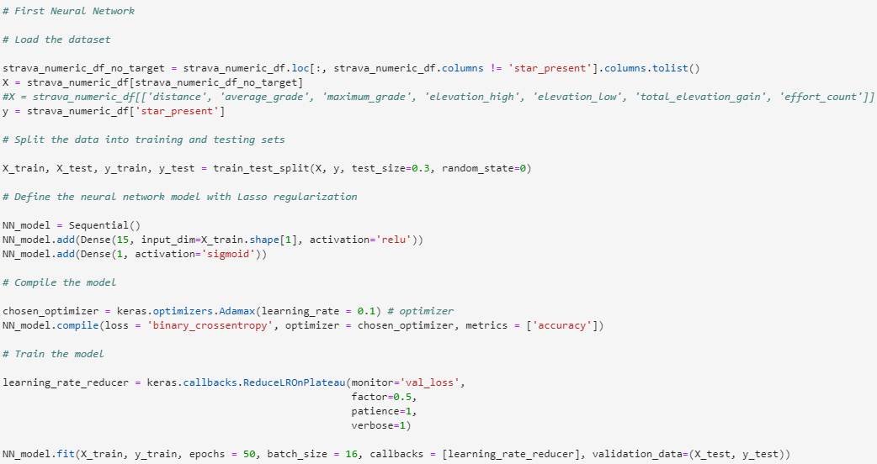
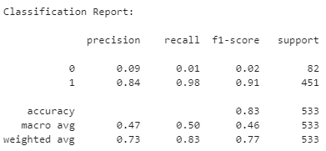
Neural Network Classifier
This was one of the worse performing models
This is indicated by the f1 score saying that the model is overclassifying 1s as 0s

Slide 9
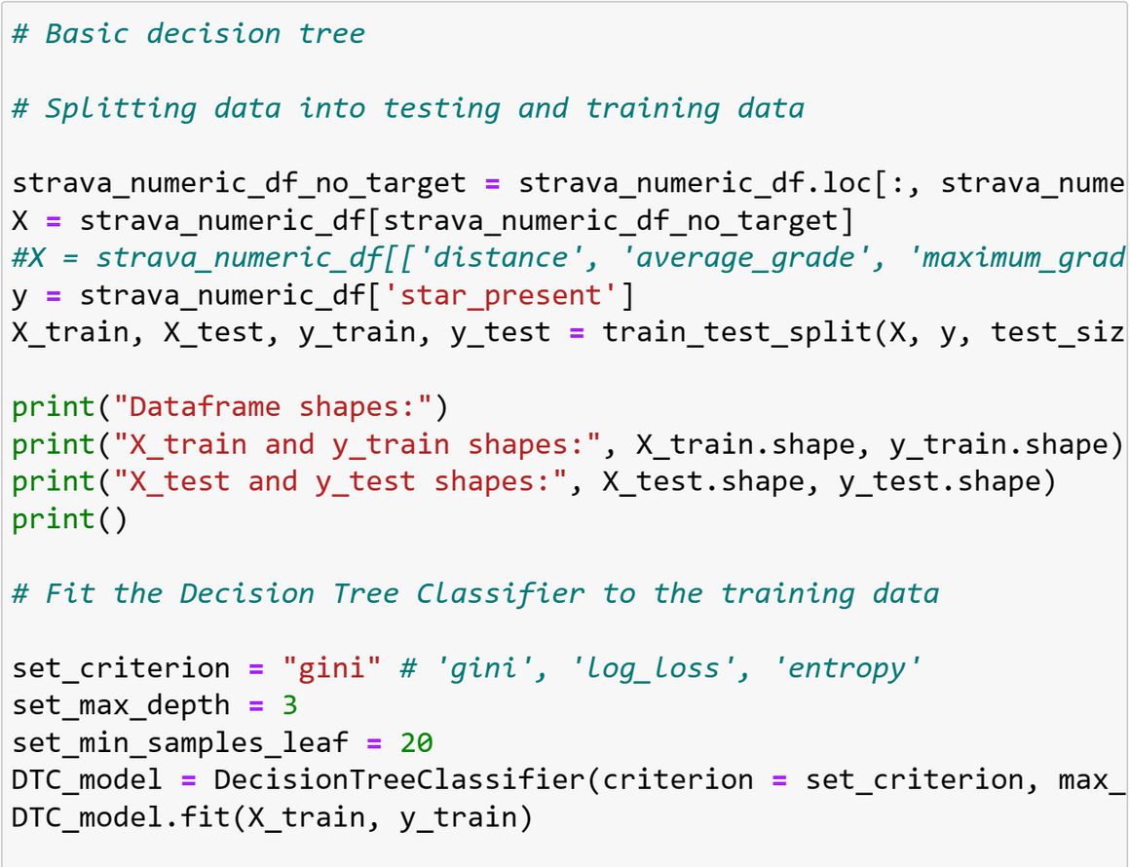
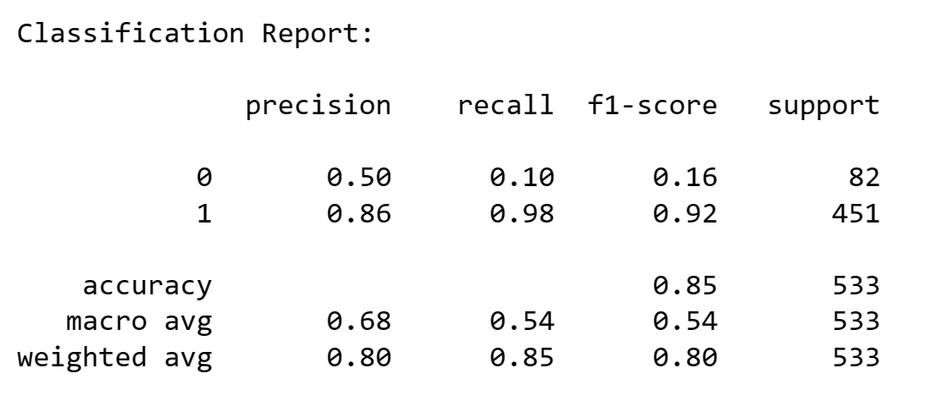
Decision Tree Classifier
This is one of the better performing models
The f1 score indicates that it is still classifying 1s better than 0s although it is better at classifying 0s than other models
It mostly can improve on recalling 0s better

Slide 10
MACHINE LEARNING 1ST HYPOTHESIS - POST ANALYSIS
Models used to predict if a star was present:
Logit, KNN, SVM, neural network, decision tree, and random forest.
Best at performing models
Logit, decision tree, and random forest
Decent models
KNN and SVM
Worst performing models
Neural network
All of the models struggled to accurately predict when a star wasn’t present but some models were better than others in this regard
The performance of all of the models would be improved if the distribution of the variable star present is closer to being uniform
This will require more data - either original or synthetic

Slide 11
2ND QUESTION ANALYSIS

Slide 12
OLS Regression
Predict route fastest time
Using variables Distance, Elevation Gain, and Average Grade, predict the fastest time of each route by building a linear model in Python
Use the model’s prediction of fastest time in comparison the the actual fastest time to decide how competitive a route is.
If the predicted time is significantly faster that the actual record time, that means the record time is less competitive than it should be in comparson to all of the other record times, and vice versa.

Slide 13
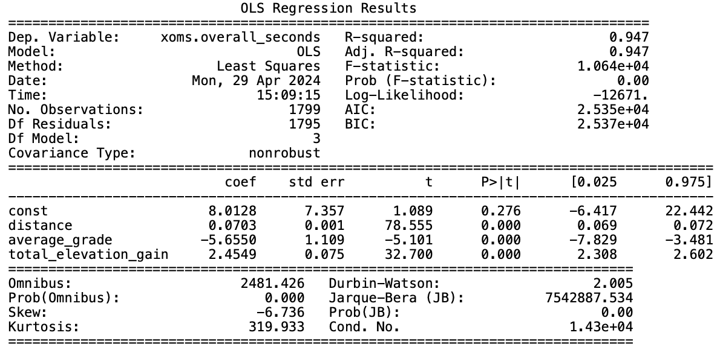
OLS Regression
Distance, average grade, and elevation gain are all significant in predicting fastest time, and together they explain 95% of the variation in fastest times.

Slide 14
INTERACTIVE VISUALIZATION
https://drive.google.com/file/d/1mqyXCeowVO4g806h3M4A9s-nvdENXMey/view?usp=share_link
https://earth.google.com/web/

Slide 15
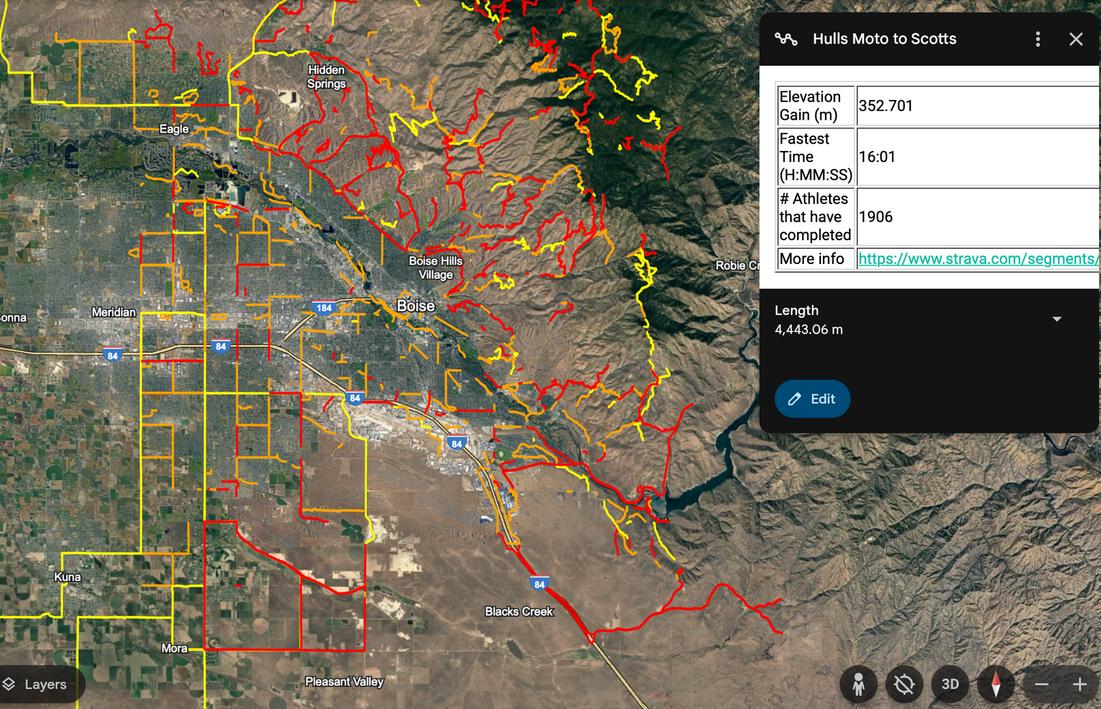

Slide 16
HYPOTHESES ANSWERS
QUESTION 1
Is there a correlation between athletes’ star ratings of a trail and factors such as distance, average grade, maximum grade, elevation changes, and effort counts?
Answer - effort count, athlete count, and elevation height wielded significant influence.
QUESTION 2
Which cycling routes exhibit the highest level of competition among athletes?
Answer - The most competitive routes are generally mountain bike trails near city centers

Slide 17
DATA MANAGEMENT PLAN
Logical Collections
Structured into datasets and systematically applied functions to each.
1 file with 1799 data points, each with 36 attributes
Physical Data Handling
Dataset - JSON converted to a CSV file
Metadata - created; TXT file
Interoperability Support- available to download in the following formats
CSV, JSON

Slide 18
DATA MANAGEMENT PLAN
Security
Full project available to download with open liscence at: https://github.com/26noahr/StravaProject
Data Ownership
Clear documentation and usage rights for the data
Metadata
Found in both the code and hosted on GitHub at: https://github.com/26noahr/StravaProject/blob/main/Dataset/Metadata.txt

Slide 19
DATA MANAGEMENT PLAN
Persistence
Stored in a long-lasting universal format, i.e. CSV
Access was limited to the research team before publication
Discovery
MetaData and data were made searchable according to Dublin Metastandards
Dissemination
Results and visualization shown through the final report
Raw data and analysis code will be made available for further exploration and validation on the public github

Slide 20
Questions?

